Slide 1

Data Visualization
Group 8: Hye-Jin Cho-Drugeon
Data: Supermarket

Slide 2
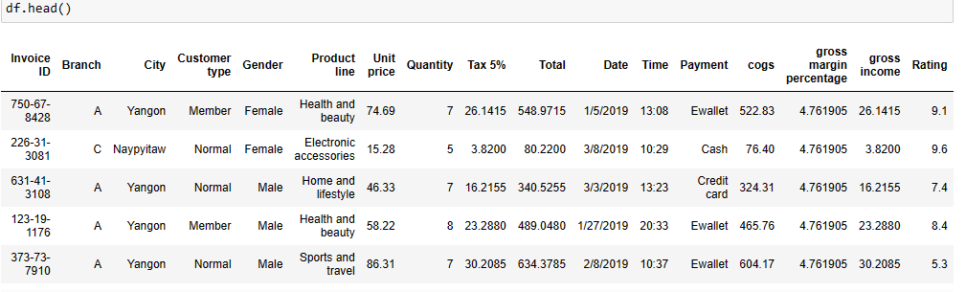

À propos
Plainly, I analyze the data frame. I would like to investigate which variables are capably explaining this data’s causality.
There are 17 columns.

Slide 3
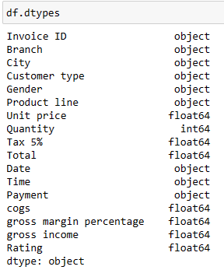
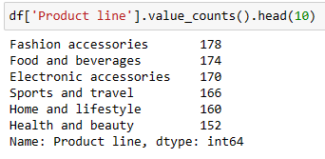
The type of variables
Variable Types
The category of Product line
Coûts
Facilité d’utilisation

Slide 4

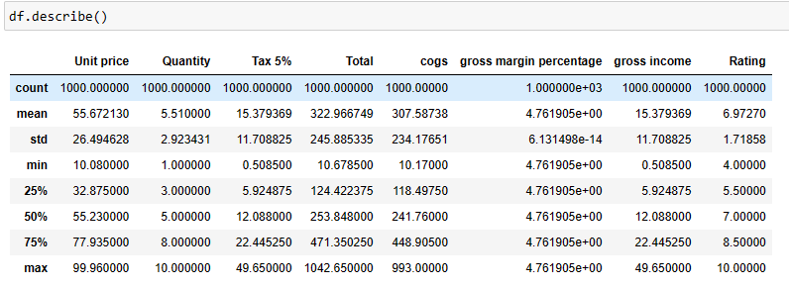
DESCRIBE
Économies
Facile d’utilisation

Slide 5




PrEsentation du produit
Replace
Null variables
Significant prcing info.
Prediction
Make the category variables to Boolean types or numeric values for the correlation check.
Relative low attention on null variables except for one abnormal variable
Prices are required for prediction analysis for next saling.
There is a tax info. which ought to be corresponding to unit prices and amounts.

Slide 6

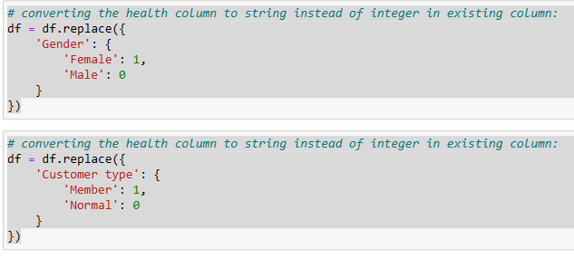
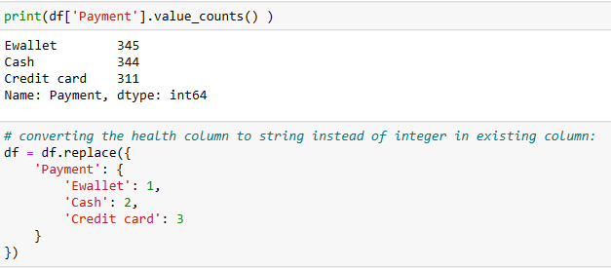
Replaces for data

Slide 7
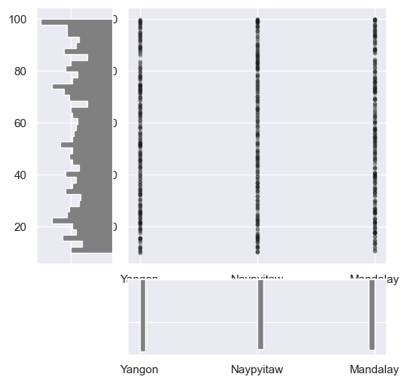
Unit price per city

Slide 8
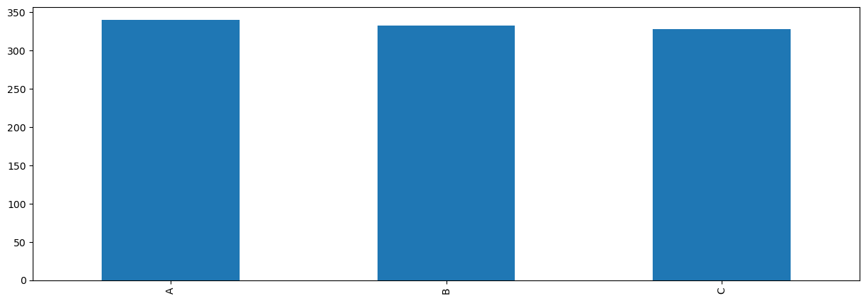
Branches

Slide 9
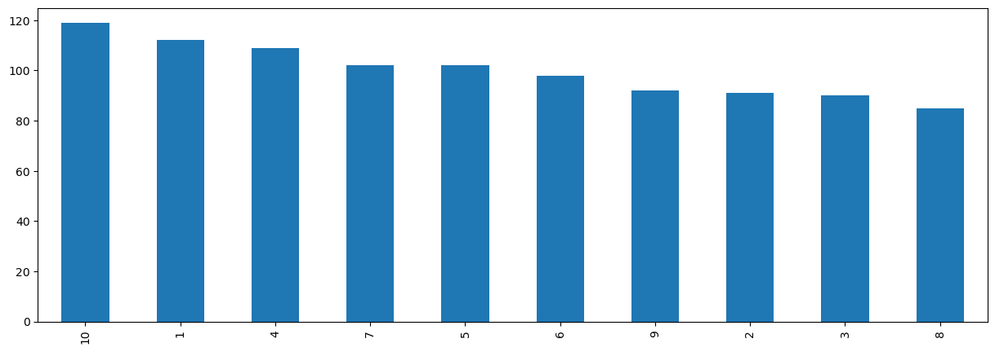
Quantity

Slide 10
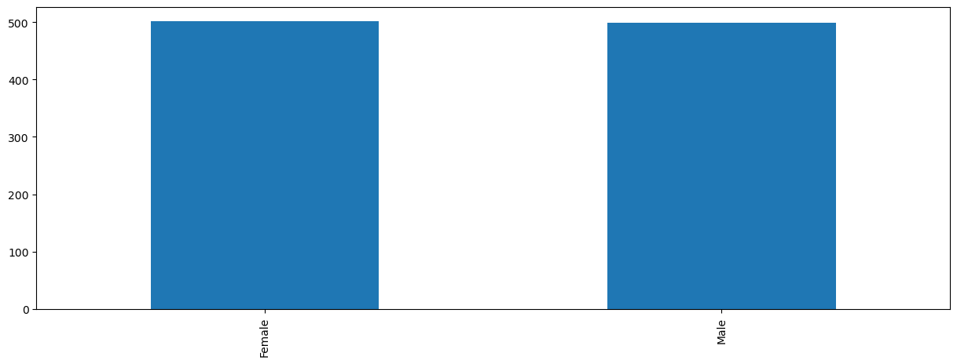
Gender

Slide 11
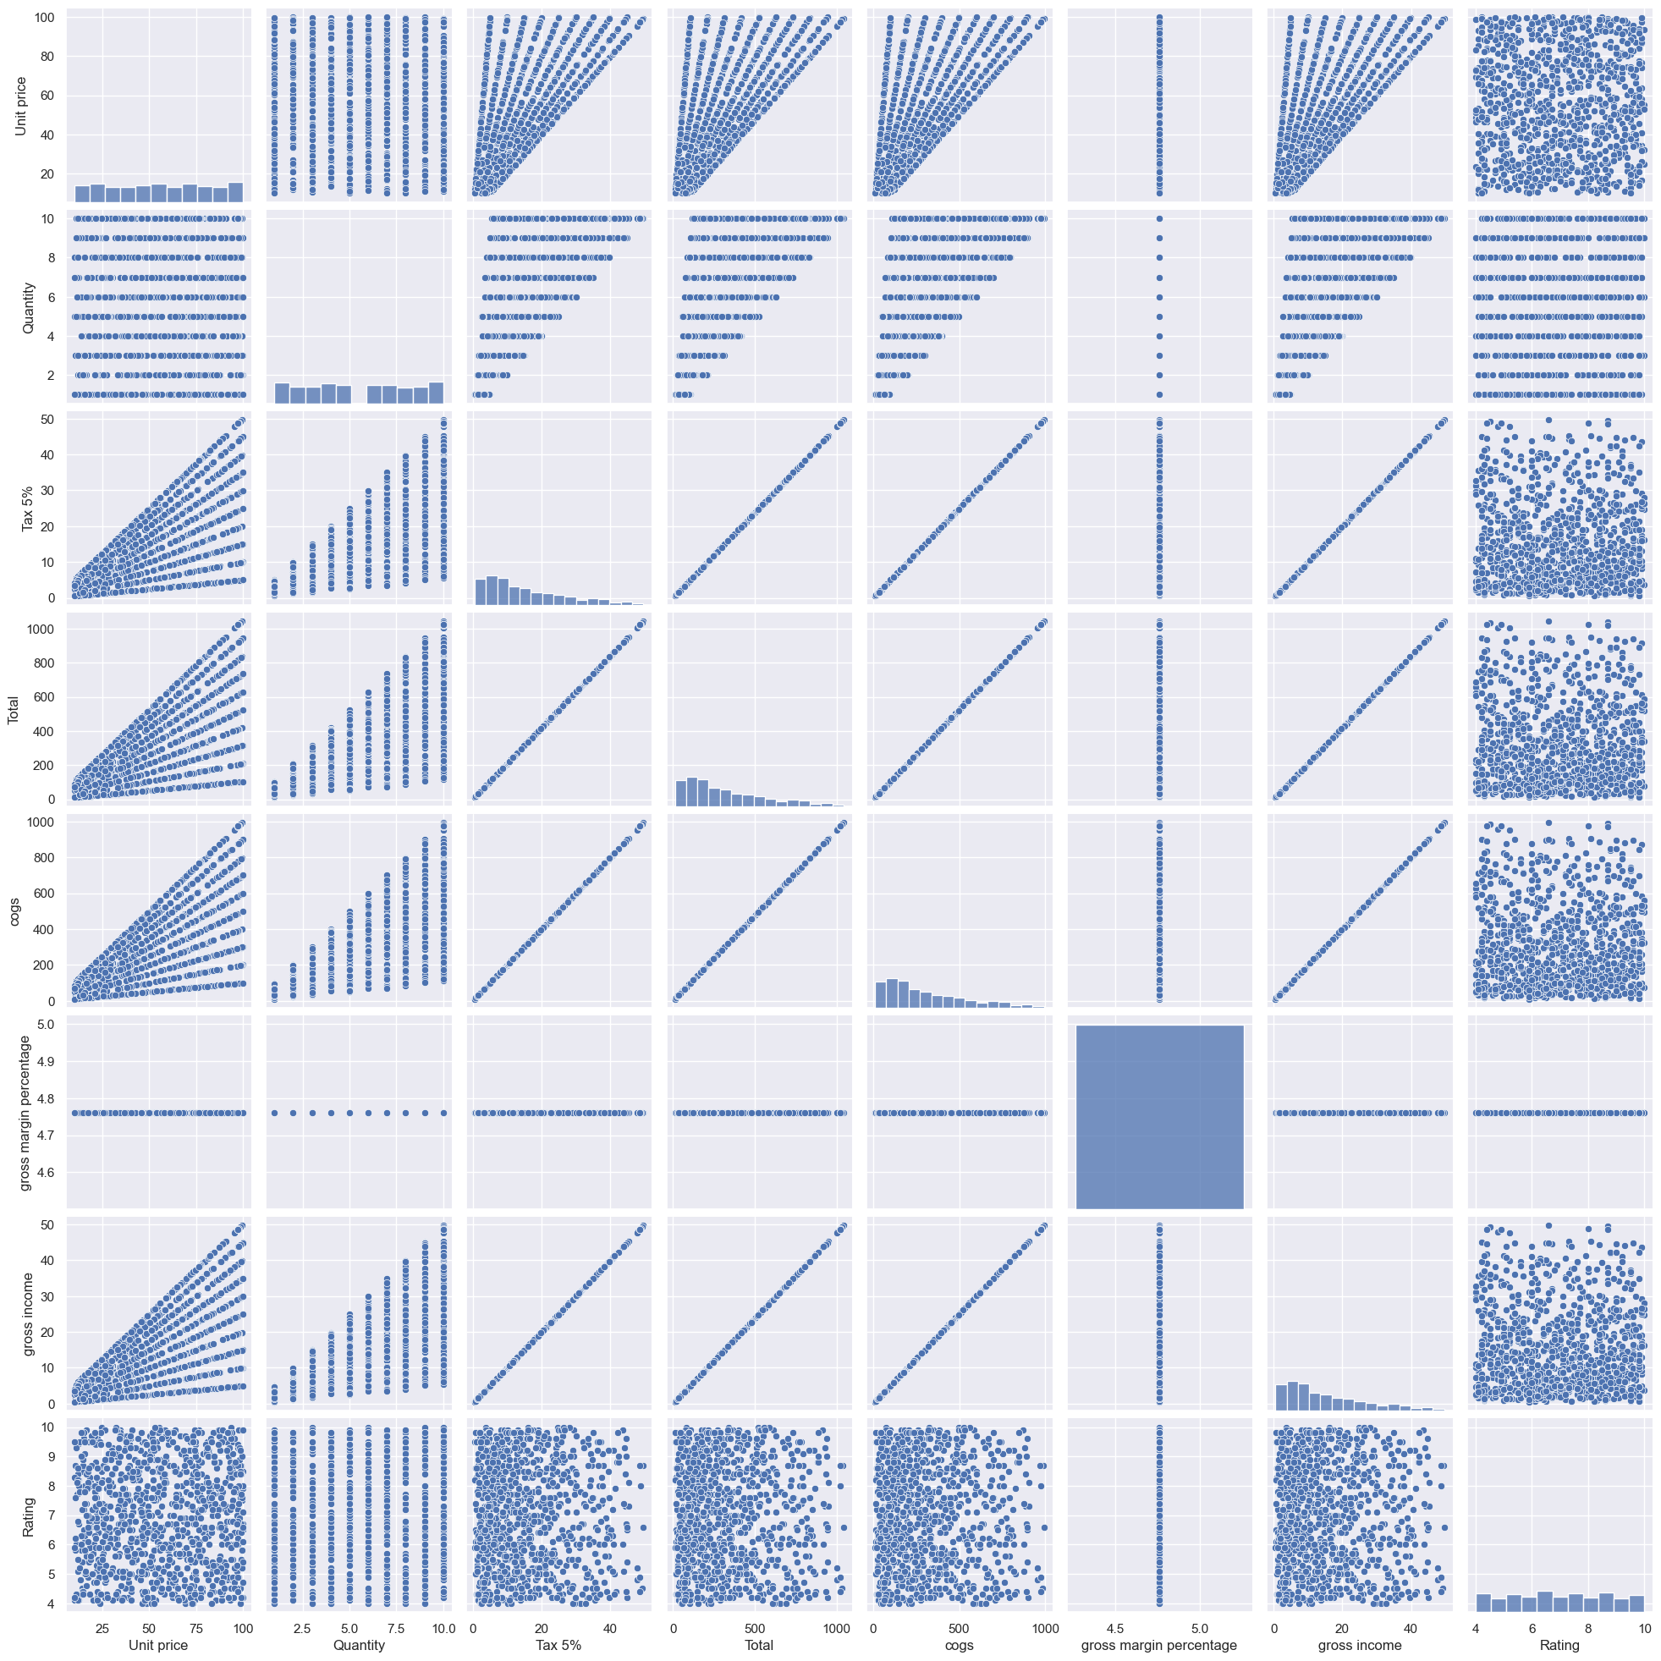
Pair plot

Slide 12
